Slide 1

BIMDAS
(now with indices)
You think you can just do your sums in any order you like? THINK AGAIN! Listen up!

Slide 2
Starter
Use a multiplication strategy to multiply the following.
21 x 45 =
342 x 23 =
2.3 x 4.1 =

Slide 3

Last lesson we looked at cubed numbers and index notation.
Let’s start by checking our notes and summary for last lesson.
Shoulder partners! Check your partner’s notes.
Are they complete and correct? Do you need to add anything to your notes?

Slide 4
24
7
30
Topic: BIMDAS
Date
EQ: How do we use indices in an equation?
Now we can use ALL of the BIMDAS process.
Order of Operations / BIMDAS
1. Brackets
2. Indicies
3. Multiply and Divide
(from left to right)
4. Add and Subtract
(from left to right)

Slide 5
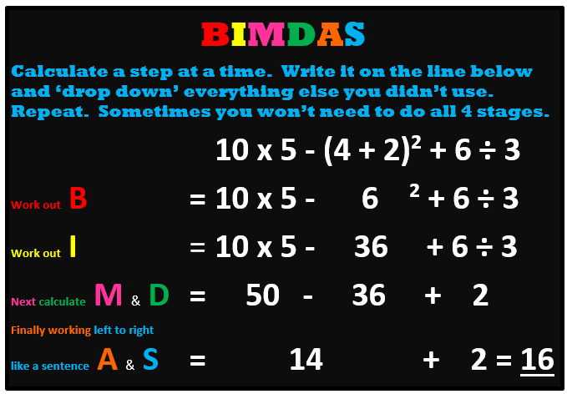

Slide 6
Yes
Solve what’s in the ( )
Start
Brackets
No
Yes
Solve indices
e.g. 2³ = 2x2x2 = 8
Indices
No
Yes
Solve operations left to right
Multiplication and division
No
Yes
Solve operations left to right
Addition and Subtraction
No
Done ☺

Slide 7


6 + 4 x 3 =
30
18
x
Who do you agree with?

Slide 8
1 + 4 x 3² =
45
28
x
Who do you agree with?

Slide 9
20 – 8 ÷ 2² =
18
3
x
Who do you agree with?

Slide 10
20 + 8² ÷ 2 =
42
52
x
Who do you agree with?

Slide 11
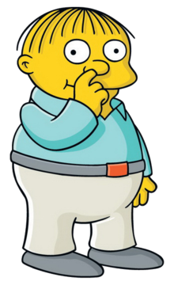
3 + 5² x 3 + 1 = 103
Ralph’s sum is wrong
We can make it right be adding a pair of brackets. Where do they need to go?

Slide 12
Create a problem time.
Write your name on a piece of paper.
1. Create a BIMDAS Problem using 1 or 2 sets of brackets and indices
2. Pass the note to the person next to you.
3. Complete the BIMDAS Puzzle and create a new one.
4. Pass the note along again. (lets see how many we can create before the end of the class).
5. When it’s time to pack up, find the person whose name is at the top of the page and hand it back to them with all the completed BIMDAS questions.

